Slide 1

Technical Presentation
ITA0602
Guided by:
Dr. Anakath S
Presented by
K. Dedeepya (192324252)

Slide 2


Implementation of Preprocessing, Post-processing, and Evaluation
Data Preprocessing
Removes unwanted or incorrect data.
Handles missing values.
Normalizes data for better performance.
Selects important features.
Post-processing
Refines model predictions.
Adjusts decision thresholds.
Displays results using graphs and charts.
Makes output easier to understand.

Slide 3
Model Evaluation
Evaluation Metrics
Accuracy – Overall correctness.
Precision – Correct positive predictions.
Recall – Finds actual positive cases.
F1-Score – Balance of precision and recall.
Validation
Train-Test Split
Cross-Validation
Result: Proper preprocessing and evaluation improve model accuracy and reliability.

Slide 4
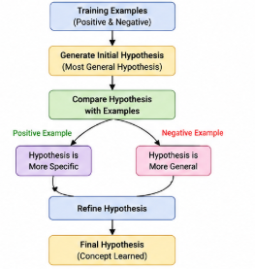
Concept Learning and Hypothesis Representation
Concept Learning
Learns rules from training examples.
Used for classification tasks.
Helps identify patterns in data.
Importance
Improves prediction accuracy.
Extracts useful knowledge.
Supports intelligent decision-making.

Slide 5
Hypothesis Representation
Hypothesis
A possible rule that explains the data.
General-to-Specific Ordering
Starts with general rules.
Refines rules using training examples.
Benefits
Better classification.
Reduced errors.
Easier knowledge extraction.

Slide 6
Decision Tree Learning and Representation
Decision Tree
A tree-like model for decision making.
Internal nodes represent features.
Branches represent conditions.
Leaves represent final decisions.
Working
Select the best feature.
Split data into groups.
Continue until classification is complete.

Slide 7
Entropy, Information Gain & Advantages
Entropy
Measures impurity in data.
Information Gain
Chooses the best feature for splitting.
Tree Pruning
Removes unnecessary branches.
Prevents overfitting.
Advantages
Easy to understand.
Fast prediction.
Works for classification problems.

Slide 8
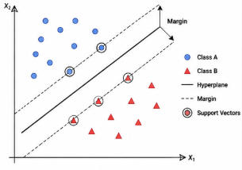
Support Vector Machines (SVM)
Support Vector Machine (SVM)
Supervised learning algorithm.
Used mainly for classification.
Key Concepts
Hyperplane separates different classes.
Support vectors are the closest data points.
Margin is the distance between classes.

Slide 9
Kernel Functions & Applications
Kernel Functions
Linear Kernel
Polynomial Kernel
RBF (Radial Basis Function)
Why Kernels?
Handle non-linear data.
Improve classification accuracy.
Applications
Face recognition
Text classification
Medical diagnosis
Spam detection

Slide 10
Model Evaluation Techniques
Train-Test Split
Training data builds the model.
Testing data checks performance.
Cross-Validation
Splits data into multiple parts.
Provides reliable performance.
Bootstrapping
Uses random sampling with replacement.
Estimates model stability.

Slide 11
Performance Metrics
Classification Metrics
Accuracy
Precision
Recall
F1-Score
Regression Metrics
Mean Absolute Error (MAE)
Mean Squared Error (MSE)
Root Mean Squared Error (RMSE)
Importance
Prevents overfitting.
Improves generalization.
Helps choose the best model.

Slide 12
THANK YOU

